Slide 1
Lesson 4
PHP Form
Handling

Slide 2
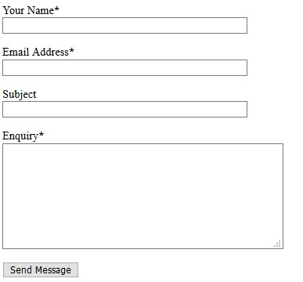
PHP Form Handling
When the user fills out a web form and clicks the submit button, the form data is sent for processing via PHP file and the form data can be sent with the HTTP POST, GET or REQUEST methods.
Dr. Hadullo Kennedy

Slide 3
PHP GET and POST
Most commonly used methods are GET & POST
Used by web browser to communicates with the server.
Communication is through HTTP (Hypertext Transfer Protocol) methods.
GET and POST are examples of superglobal variables.
What is a superglobal?.
Dr. Hadullo Kennedy

Slide 4
PHP Global Variables
SuperGlobals are several predefined variables in PHP.
Variables that are always accessible, regardless of scope.
Can be accessed from any function, class or file without having to do anything special.
Examples in PHP:
$GLOBALS
$_SERVER
$_REQUEST
$_POST
$_GET
$_FILES
$_ENV
$_COOKIE
$_SESSION
Dr. Hadullo Kennedy

Slide 5
The PHP Globals Variable
$GLOBALS is a PHP super global variable.
Used o access other global variables from anywhere in the PHP script (methods).
PHP stores all global variables in an array called $GLOBALS[index].
The index holds the name of the variable.
The example below shows how to use the super global variable $GLOBALS:
Dr. Hadullo Kennedy

Slide 6
PHP Global Variables(3)
<?php
$x = 75;
$y = 25;
function addition() {
$GLOBALS['z'] = $GLOBALS['x'] + $GLOBALS['y'];
}
addition();
echo $z;
?>
in the example above, since z is a variable present within the $GLOBALS array, it is also accessible from outside the function!
Dr. Hadullo Kennedy

Slide 7



HTTP GET method
<form action=“get_script.php" method="get">
Name: <input type="text" name="name"><br>
E-mail: <input type="text" name="email"><br>
<input type="submit">
</form>
1
2
3
get_script.php
Welcome <?php echo $_GET["name"]; ?><br>
Your email address is: <?php echo $_GET["email"]; ?>
4
5
6
http://localhost/php-lesson-scripts/forms/welcome_get.php?name=hadullo&email=khadullo%40gmail.com
Dr. Hadullo Kennedy

Slide 8
Advantages and Disadvantages of GET
Advantage
Since the data sent by the GET method are displayed in the URL, it is possible to bookmark the page with specific query string values.
Disadvantage.
The GET method is not suitable for passing sensitive information such as the username and password, because these are fully visible in the URL query string as well as potentially stored in the client browser's memory as a visited page.
Because the GET method assigns data to a server environment variable, the length of the URL is limited. So, there is a limitation for the total data to be sent.
Dr. Hadullo Kennedy

Slide 9
GET Method Explained
In GET method, the data is sent as URL parameters that are usually strings of name and value pairs separated by ampersands (&).
In general, a URL with GET data will look like this.
http://www.example.com/action.php?name=john&age=24.
The bold parts in the URL are the GET parameters and the italic parts are the value of those parameters.
More than one parameter=value can be embedded in the URL by concatenating with ampersands (&).
One can only send simple text data via GET method.
Dr. Hadullo Kennedy

Slide 10

HTTP POST method
<form action=“post_script.php" method=“post">
Name: <input type="text" name="name"><br>
E-mail: <input type="text" name="email"><br>
<input type="submit">
</form>
1
2
3
get_script.php
Welcome <?php echo $_POST["name"]; ?><br>
Your email address is: <?php echo $_POST["email"]; ?>
4
5
6
Dr. Hadullo Kennedy

Slide 11
Advantages and Disadvantages POST
It is more secure than GET because user-entered information is never visible in the URL query string or in the server logs.
There is a much larger limit on the amount of data that can be passed and one can send text data as well as binary data (uploading a file) using POST.
Since the data sent by the POST method is not visible in the URL, so it is not possible to bookmark the page with specific query.
Dr. Hadullo Kennedy

Slide 12
The $_SERVER["PHP_SELF"] variable
What is the $_SERVER["PHP_SELF"] variable?
The $_SERVER["PHP_SELF"] is a super global variable that returns the filename of the currently executing script.
So, the $_SERVER["PHP_SELF"] sends the submitted form data to the page itself, instead of jumping to a different page.
Form processing is done by a script within the page.
Incase of an error, error messages are displayed on the same page.
Dr. Hadullo Kennedy

Slide 13
PHP REQUEST variable
PHP provides another superglobal variable $_REQUEST that contains the values of both the $_GET and $_POST superglobal variables.
The superglobal variables $_GET, $_POST and $_REQUEST are built-in variables that are always available in all scopes throughout a script.
Dr. Hadullo Kennedy

Slide 14
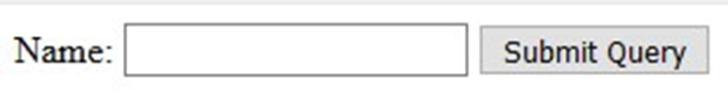
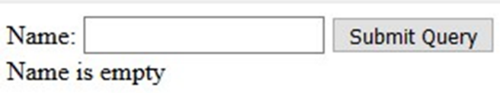

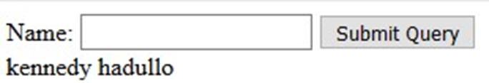
Capturing inputs by $_REQUEST
<form method="post" action="<?php echo $_SERVER['PHP_SELF'];?>">
Name: <input type="text" name="fname">
<input type="submit">
</form>
<?php
if ($_SERVER["REQUEST_METHOD"] == "POST") {
// collect value of input field
$name = $_REQUEST['fname'];
if (empty($name)) {
echo "Name is empty";
} else {
echo $name;
}
}
?>
Dr. Hadullo Kennedy

Slide 15
Capturing inputs by $_POST
<form method="post" action="<?php echo $_SERVER['PHP_SELF'];?>">
Name: <input type="text" name="fname">
<input type="submit">
</form>
<?php
if ($_SERVER["REQUEST_METHOD"] == "POST") {
// collect value of input field
$name = $_POST['fname'];
if (empty($name)) {
echo "Name is empty";
} else {
echo $name;
}
}
?>
Dr. Hadullo Kennedy

Slide 16
PHP Form Validation
Can be done by some functions.
E.g. the htmlspecialchars() function
This function converts special characters to HTML entities.
Characters are harmful. Entities are harmless.
It replaces HTML characters like < and > with entities like &lt; and &gt;.
Hackers use such scripts via HTML or JavaScript.
This is called Cross-site Scripting attacks.
Dr. Hadullo Kennedy

Slide 17
Validation Process
The first thing we will do is to pass all variables through PHP's htmlspecialchars() function.
The htmlspecialchars() function converst this code:
<script>location.href('http://www.hacked.com')</script>
To this code:&lt;script&gt;location.href('http://www.hacked.com')&lt;/script&gt;
This code has HTML escaped code.
The code is now safe to be displayed on a page or inside an e-mail.
Dr. Hadullo Kennedy

Slide 18
More Validation Functions
Next, we do two more things:
  Strip unnecessary characters (extra space, tab, newline) from the user input data (with the PHP trim() function)
  Remove backslashes (\) from the user input data (with the PHP stripslashes() function).
This can be done by creating a function that will do all the checking for us (which is much more convenient than writing the same code over and over again).
We will name the function test_input().
The test_input () is then used to check all the $_POST variables
Dr. Hadullo Kennedy

Slide 19
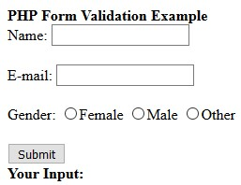
Validating HTML Form
Name: <input type="text" name="name">
E-mail: <input type="text" name="email">
Gender:
<input type="radio" name="gender" value="female">Female
<input type="radio" name="gender" value="male">Male
<input type="radio" name="gender" value="other">Other
Dr. Hadullo Kennedy

Slide 20
Checking $_POST variables with test_input() function
<?php
// define variables and set to empty values
$name = $email = $gender = "";
if ($_SERVER["REQUEST_METHOD"] == "POST") {
$name = test_input($_POST["name"]);
$email = test_input($_POST["email"]);
$gender = test_input($_POST["gender"]);
}
function test_input($data) {
$data = trim($data);
$data = stripslashes($data);
$data = htmlspecialchars($data);
return $data;
}
?>
Dr. Hadullo Kennedy

Slide 21
Checking $_POST variables with test_input() function
Notice that at the start of the script, we check whether the form has been submitted using $_SERVER["REQUEST_METHOD"].
If the REQUEST_METHOD is POST, then the form has been submitted - and it should be validated.
If it has not been submitted, skip the validation and display a blank form.
The next step is to make input fields required and create error messages if needed.
Dr. Hadullo Kennedy

Slide 22
Identifying the Required Fields
From the validation rules table on the previous page, we see that the "Name", "E-mail", and "Gender" fields are required.
These fields cannot be empty and must be filled out in the HTML form.
Field Validation Rules
Name Required. + Must only contain letters and whitespace
E-mail Required. + Must contain a valid email address (with @ and .)
Gender Required. Must select one
Dr. Hadullo Kennedy

Slide 23
Required Fields
In the following code we have added some new variables: $nameErr, $emailerErr and $genderErr.
These error variables will hold error messages for the required fields.
We have also added an if else statement for each $_POST variable.
This checks if the $_POST variable is empty (with the PHP empty() function).
If it is empty, an error message is stored in the different error variables, and if it is not empty, it sends the user input data through the test_input() function:
Dr. Hadullo Kennedy

Slide 24
Required Fields
<?php
// define variables and set to empty values
$nameErr = $emailErr = $genderErr = "";
$name = $email = $gender = "";
if ($_SERVER["REQUEST_METHOD"] == "POST") {
if (empty($_POST["name"])) {
$nameErr = "Name is required";
} else {
$name = test_input($_POST["name"]);
}
if (empty($_POST["email"])) {
$emailErr = "Email is required";
} else {
$email = test_input($_POST["email"]);
}
if (empty($_POST["gender"])) {
$genderErr = "Gender is required";
} else {
$gender = test_input($_POST["gender"]);
}
}
?>
Dr. Hadullo Kennedy

Slide 25
Displaying error Messages
<form method="post" action="<?php echo htmlspecialchars($_SERVER["PHP_SELF"]);?>">
Name: <input type="text" name="name">
<span class="error">* <?php echo $nameErr;?></span>
<br><br>
E-mail:
<input type="text" name="email">
<span class="error">* <?php echo $emailErr;?></span>
<br><br>
Gender:
<input type="radio" name="gender" value="female">Female
<input type="radio" name="gender" value="male">Male
<input type="radio" name="gender" value="other">Other
<span class="error">* <?php echo $genderErr;?></span>
<br><br>
<input type="submit" name="submit" value="Submit">
</form>
?>
Dr. Hadullo Kennedy

Slide 26
Displaying error Messages
The next step is to validate the input data, that is "Does the Name field contain only letters and whitespace?", and "Does the E-mail field contain a valid e-mail address syntax?", and if filled out etc.
Dr. Hadullo Kennedy

Slide 27
PHP - Validate Name
The code below shows a simple way to check if the name field only contains letters and whitespace.
If the value of the name field is not valid, then store an error message.
$name = test_input($_POST["name"]);
if (!preg_match("/^[a-zA-Z ]*$/",$name)) {
$nameErr = "Only letters and white space allowed";
}
The preg_match() function searches a string for pattern, returning true if the pattern exists, and false otherwise.
Dr. Hadullo Kennedy

Slide 28
PHP - Validate E-mail
The easiest and safest way to check whether an email address is well-formed is to use PHP's filter_var() function.
In the code below, if the e-mail address is not well-formed, then store an error message:
$email = test_input($_POST["email"]);
if (!filter_var($email, FILTER_VALIDATE_EMAIL)) {
$emailErr = "Invalid email format";
}
Dr. Hadullo Kennedy

Slide 29
PHP - Validate URL
The code below shows a way to check if a URL address syntax is valid (this regular expression also allows dashes in the URL).
If the URL address syntax is not valid, then store an error message:
$website = test_input($_POST["website"]);
if (!preg_match("/\b(?:(?:https?|ftp):\/\/|www\.)[-a-z0-9+&@#\/%?=~_|!:,.;]*[-a-z0-9+&@#\/%=~_|]/i",$website)) {
$websiteErr = "Invalid URL";
}
Dr. Hadullo Kennedy

Slide 30
The end
Thank You
Qs???
Dr. Hadullo Kennedy

